Slide 1
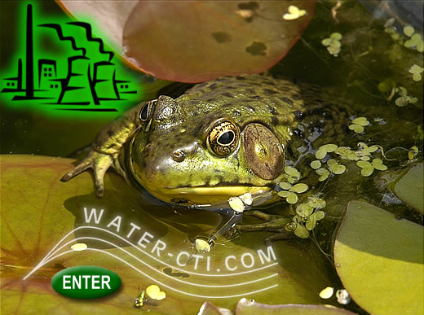
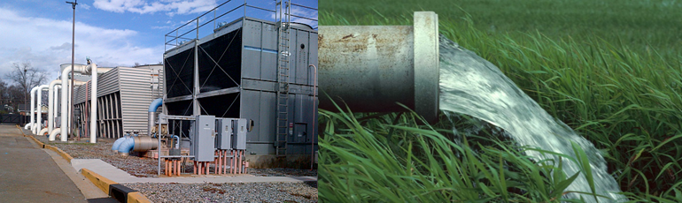
WELCOME
Save America Water
Ei Cooling Tower Blowdown Initiative

Slide 2
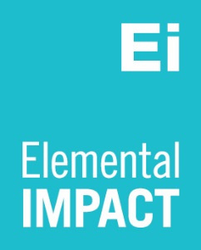
AGENDA
Ei Cooling Tower Blowdown Initiative
Benefits
WCTI Technology
Equipment
The World’s Busiest Airport
Q&A

Slide 3
Ei Cooling Tower Blowdown Initiative
WCTI technology…it’s Nature’s Way.
WCTI technology saves more water and more money than any other method.
It Is Double Green™.

Slide 4
Ei Cooling Tower Blowdown Initiative
Eliminates blowdown and the constant chemical discharge too!
Clients include Apple, Boeing, Microsoft , Universal Studios and Verizon.

Slide 5
Ei Cooling Tower Blowdown Initiative
Additional Benefits
Fast ROI
Retrofits are easy.
LEED points are available.
Works with well water.
Works with gray water.

Slide 6

Ei Cooling Tower Blowdown Initiative
Evaporative Cooling

Slide 7
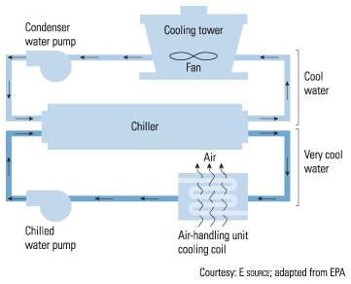
Ei Cooling Tower Blowdown Initiative
Evaporative Cooling

Slide 8

Ei Cooling Tower Blowdown Initiative
Machines Hate Tap Water

Slide 9
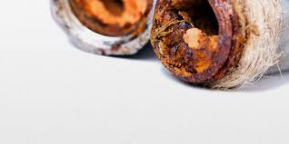
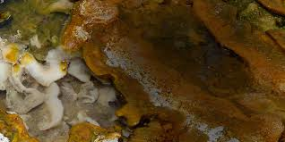
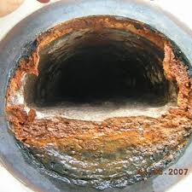
Ei Cooling Tower Blowdown Initiative
Water Must Be Treated to Prevent Scale, Corrosion & Bio-fouling

Slide 10
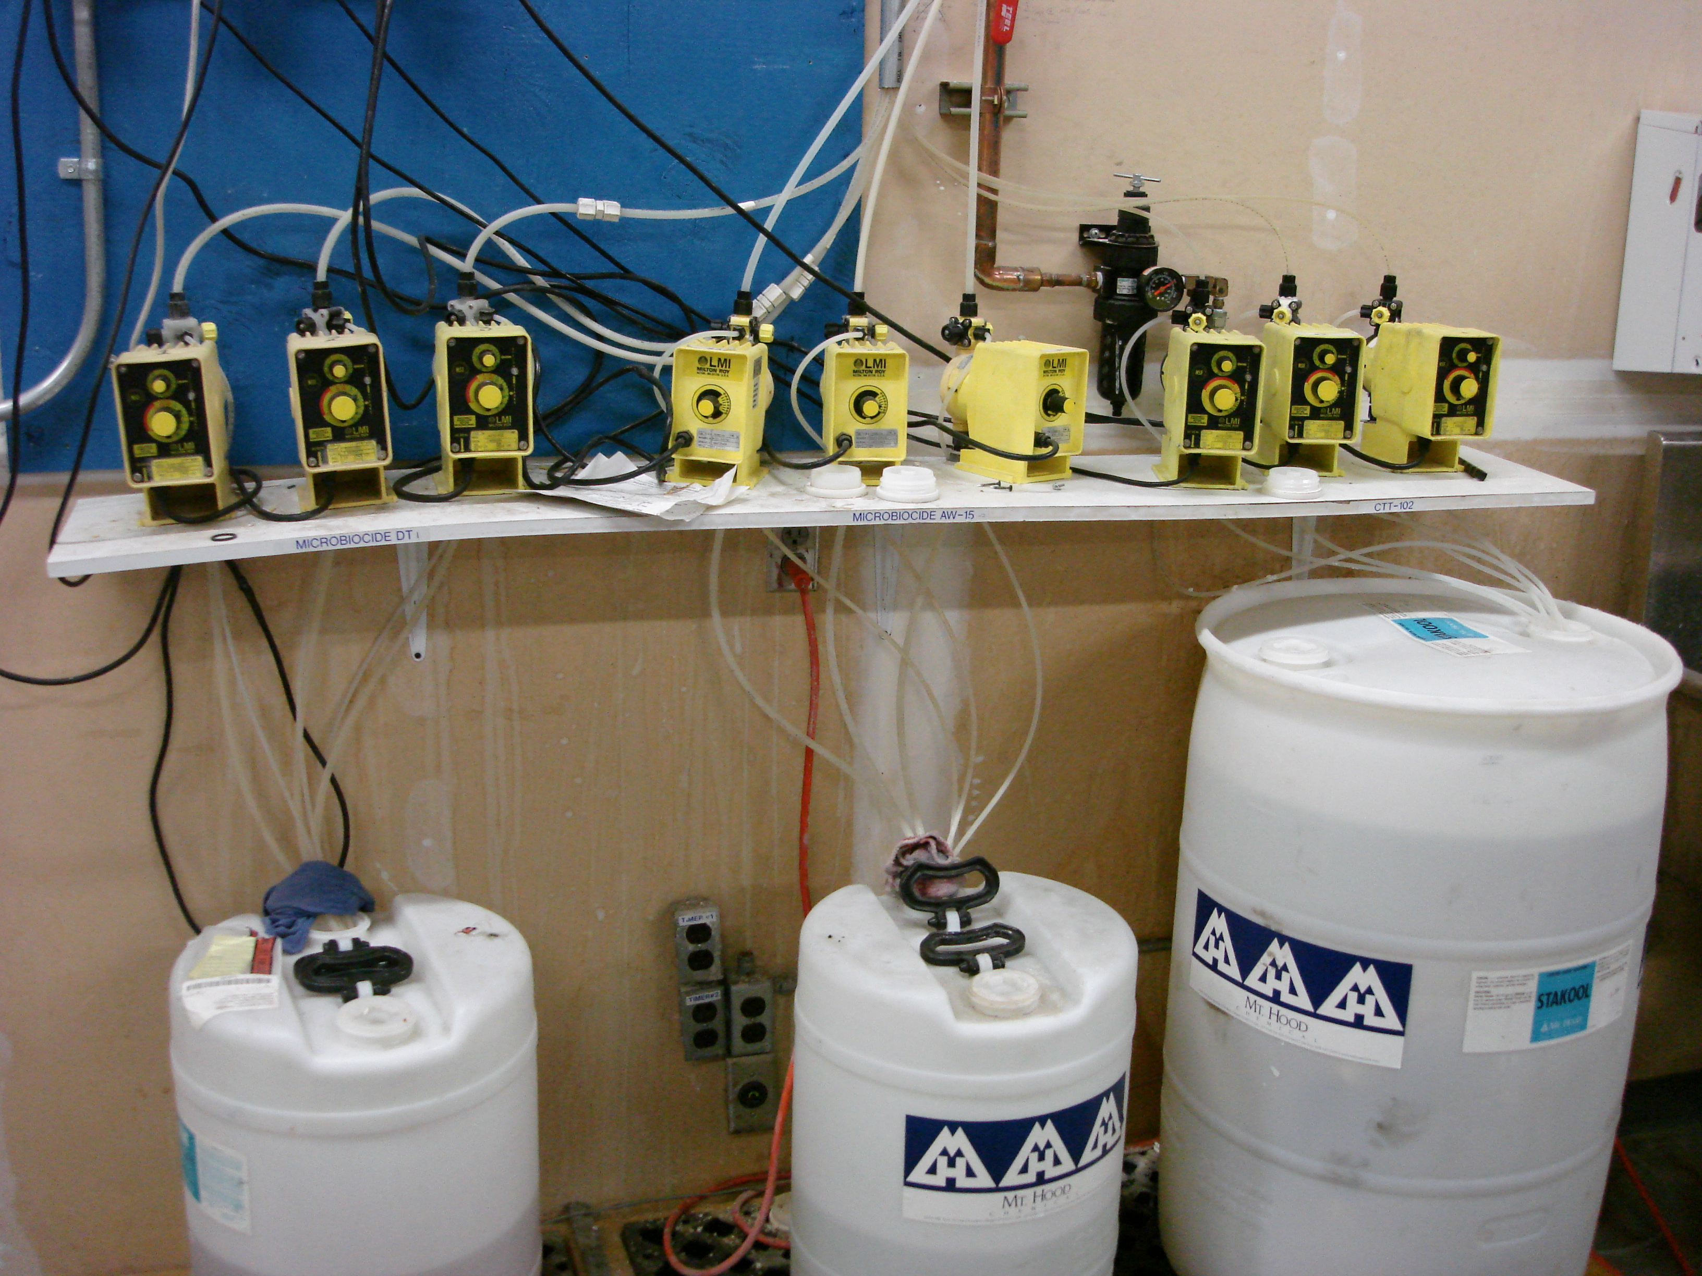
Ei Cooling Tower Blowdown Initiative
Traditional Chemical Treatment

Slide 11
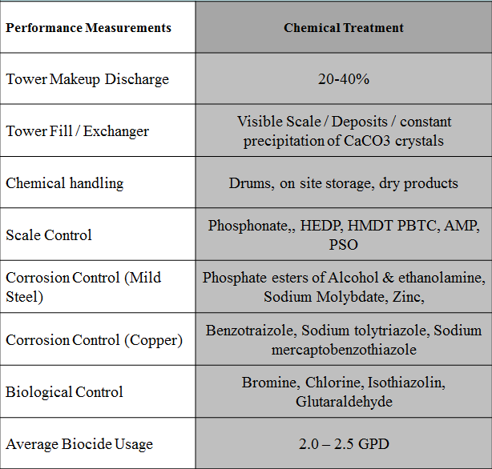
Ei Cooling Tower Blowdown Initiative
Typical Chemicals Used

Slide 12
Ei Cooling Tower Blowdown Initiative
Traditional Chemical Treatment Wastes Water
As the water evaporates, the chemicals are left behind.
To keep the chemicals in effective balance, water must be drained and more water brought in.
This “blowdown” can be 10 to 35 percent of water consumed.
Water and sewer costs for this “blowdown” can be significant!

Slide 13

Ei Cooling Tower Blowdown Initiative
Dan Duke, founder of WCTI, discovered in 2000 if you use a super softener to remove the hardness(calcium and magnesium) down to a gnat’s hair,
Mother Nature will give you corrosion and bio-fouling protection, for free!

Slide 14
Ei Cooling Tower Blowdown Initiative
WCTI Methodology
1. High Efficiency Softener (HES) uses sodium (Na) zeolite resin to eliminate the hardness(Ca and Mg) in the tower supply water.
2. Resin absorbs Ca and Mg and exchanges with Na for a one-to-one exchange.
Naturally occurring pH climbs to >9.3 < 10.0 and along with the high TDS(total dissolved solids) prevents biological growth.
3. Silica is naturally polymerized with the increased pH and high TDS in the absence of hardness.
4. The resulting NaSiO2, sodium silicate, is considered an excellent corrosion inhibitor and is naturally formed under WCTI conditions.
RESULTS: NO scale and effective control of corrosion and biological growth – eliminates the need for chemical additives and blowdown

Slide 15
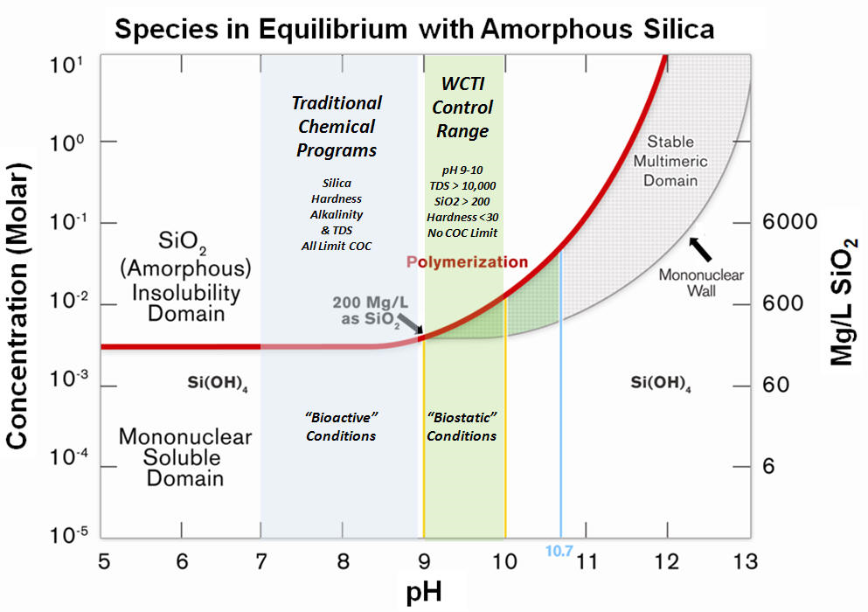
Ei Cooling Tower Blowdown Initiative
SILICA BASED TECHNOLOGY

Slide 16
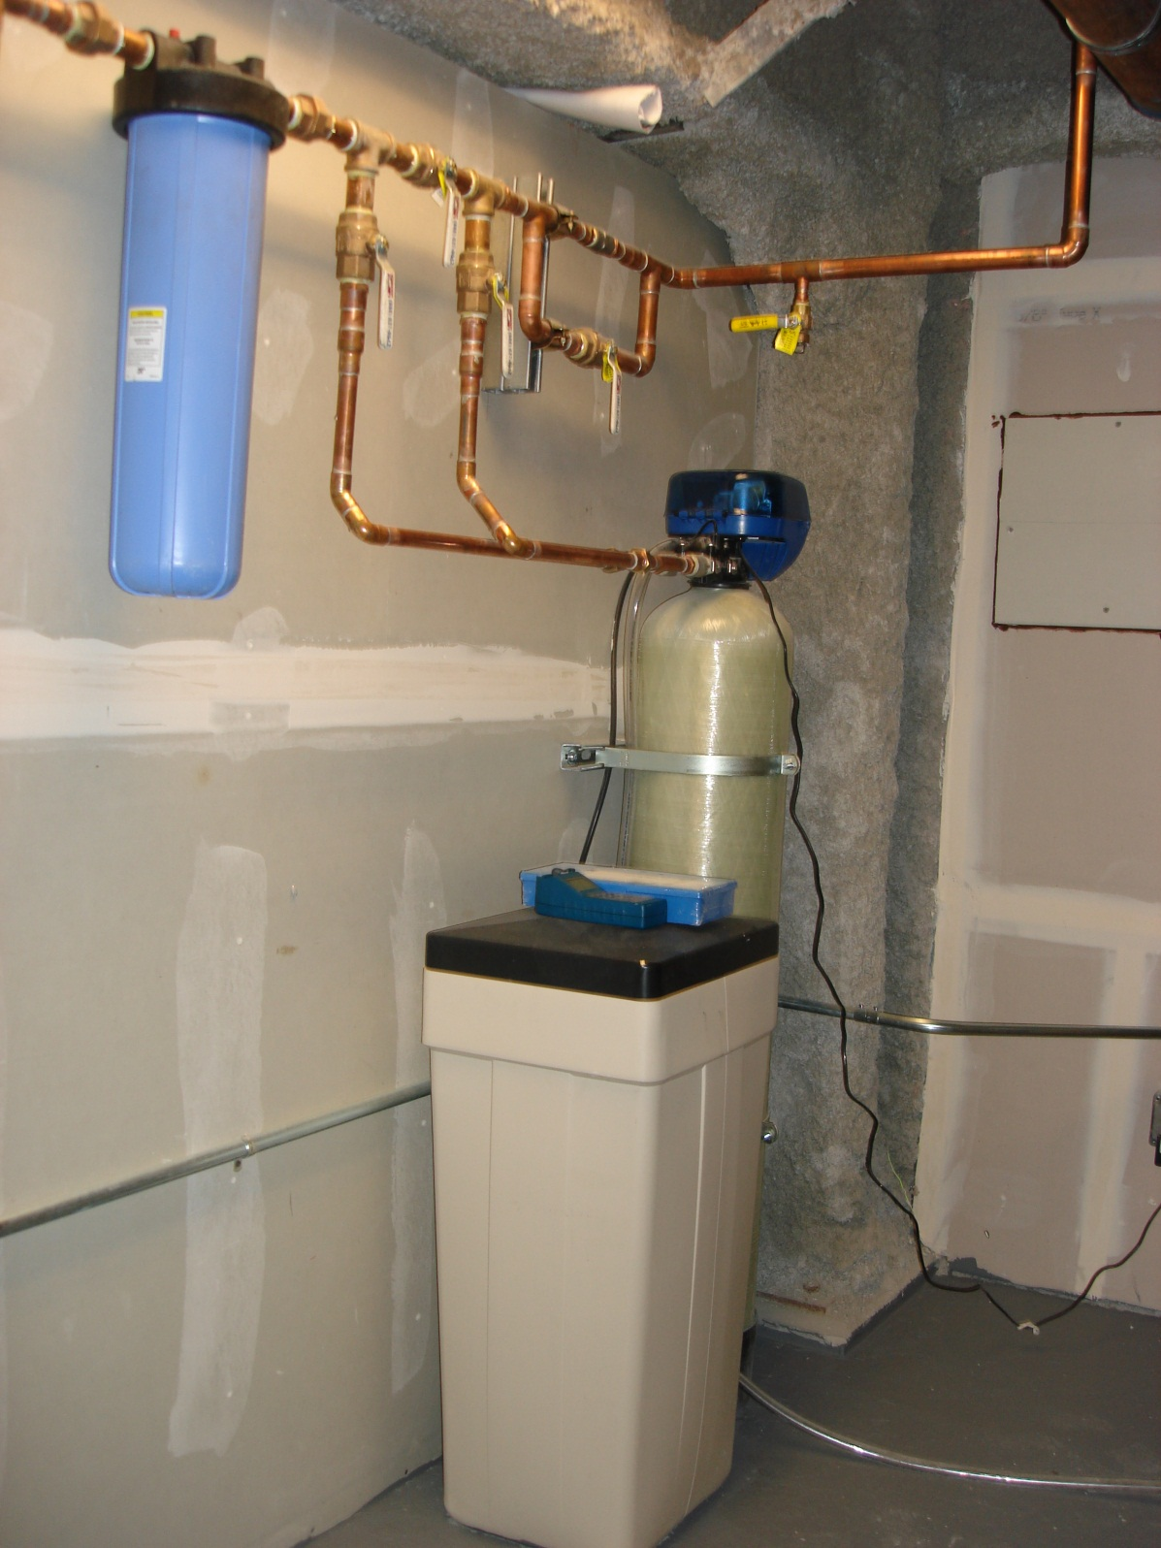
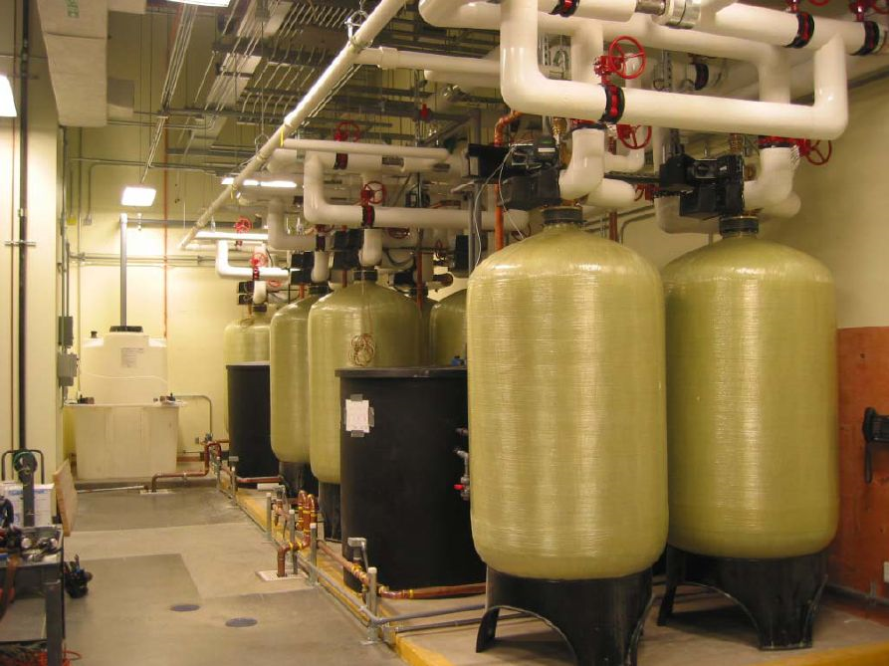
Ei Cooling Tower Blowdown Initiative
SIMPLE EQUIPMENT SET-UPS

Slide 17
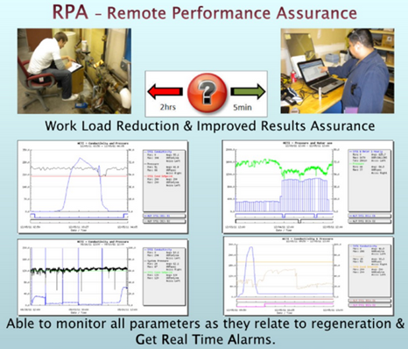
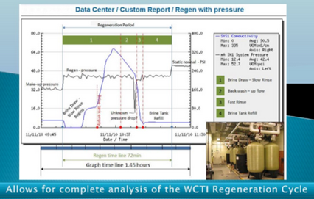
Ei Cooling Tower Blowdown Initiative
RPA

Slide 18
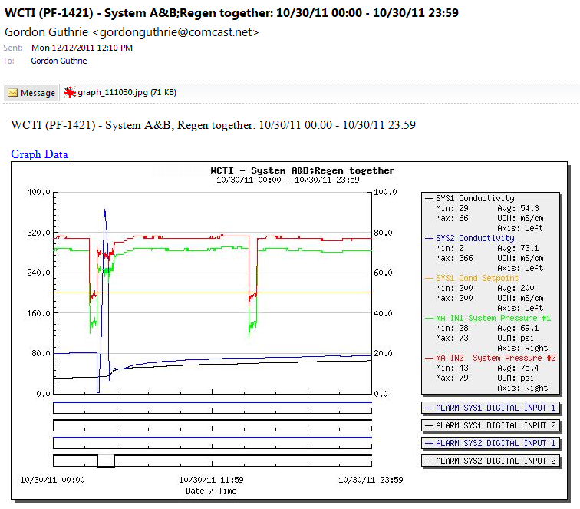
RPA Supports Your Water & Asset Management
Daily Emailed Status Reports on Critical plant control requirements such as:
Water use
Pressure
Regeneration
Power failure alarm

Slide 19
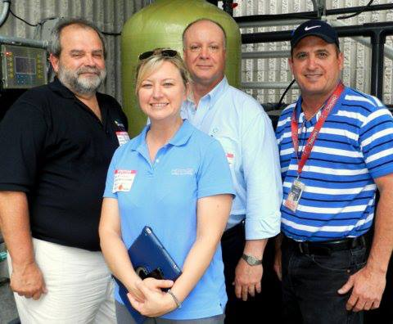
Ei Cooling Tower Blowdown Initiative
Ei Water Use & Toxicity Platform
Ei Cooling Tower Blowdown Initiative
The Ei team visited the WCTI installation at the Verizon data center in Tampa, Florida on May 22, 2013
As a strategic partner, Ei introduced WCTI to prospects including:
  Georgia World Congress Center
  Hartsfield-Jackson Atlanta International Airport.

Slide 20
Ei Cooling Tower Blowdown Initiative
World’s Busiest Airport
Preliminary Numbers & Assumptions
Two Chiller Plants: 10,000 tons & 16,500 tons
Average Annual Load Factor: 20%
Water & Sewer Source: City of Atlanta
Water/Sewer Cost is $28 per 1000 gallons
Cooling Water Treatment: Chemical

Slide 21
Ei Cooling Tower Blowdown Initiative
World’s Busiest Airport
Preliminary Analysis
Save 7 to 10 million gallons of water each year
Save $185,000 to $250,000 per year in water/sewer cost

Slide 22

Ei Cooling Tower Blowdown Initiative
No Other Method Saves As Much Water

Slide 23

Ei Cooling Tower Blowdown Initiative
Return On Investment is Fast
6 – 24 Months

