Slide 1
Atlanta’s Zero Waste Journey
U.S. Zero Waste Business Council Conference
May 7, 2014
Notes:
Stan Meiburg, Steve O'Day, Dennis Creech, Brian Gist, Gil Rogers, Alice Rolls and Mandy Mahoney. None of them has spoken broadly about sustainability in cities and communities and the standards around that. I think they'll find that interesting, as well as hearing about Look Up.

Slide 2
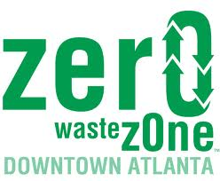
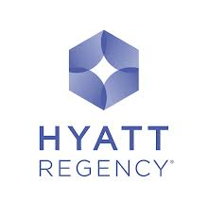
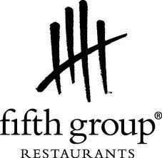
Birth of Atlanta Zero Waste Zone
Notes:
DNR Sustainability Division focused on providing technical assistance to businesses implementing sustainability best practices, and saw that the Zero Waste Zone effort was a great tool for creating momentum around diversion of valuable materials in downtown Atlanta. A number of our Partnership for a Sustainable Georgia members participated in the initiative. Our staff played a critical role in assisting ZWZ participants with waste assessments, trainings and finding homes from some of the materials generated outside of commodity recyclables and organics.
Unfortunately, during a time of deep budget cuts within the Dept., our division and programming was eliminated. I know that as the ZWZ effort expanded in Atlanta to midtown and the airport, it continued to build momentum and you’ll hear much more about these continued efforts from other speakers over the next 2 days.

Slide 3
Sustainable Atlanta’s Role Today
Our Mission
Fostering collaborative solutions that grow shared prosperity for our metro communities
Our Work
We bring together partners across the region to
Inspire, educate and connect
Amplify our sustainability stories
Engage a broader audience in action
Accelerate our progress

Slide 4
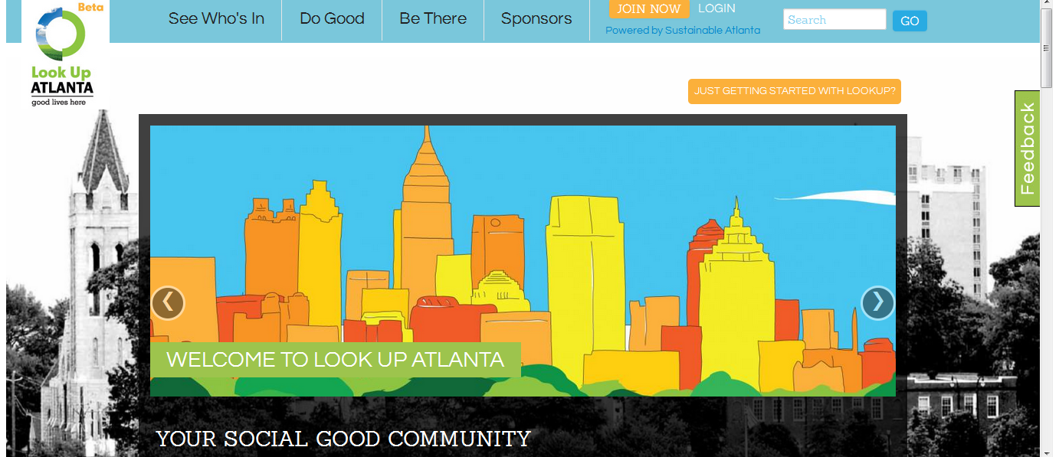
RECIPE FOR BUILDING SUSTAINABILITY MOVEMENT
Mix one part
+ one part
+ one part
+ two parts
=
Notes:
We see zero waste champions all around the region – individuals, in churches, schools, small businesses and corporate HQs – and help them tell their stories to inspire others
Videos – Palookaville, great new piece about recycling infrastructure in GA
LBC, Reclaim It,
Republic Waste about Raphael
Global Paint
Re:Loom social enterprise waste diversion
Center for Hard to Recycle Materials
Anamarie Shreeves blog posts on how to achieve a zero waste move or posts about a plastic film recycling pilot
Dozens of recycling events

Slide 5
Notes:
In practice, an EcoDistrict is a community that defines how it wants to interact with things like transit, local food, and even waste to create a place that suits the needs and wants of its members, creating a resilient, sustainable and most of all proud community.
It is a next generation neighborhood that combines livability, green infrastructure
and community decision-making.
An EcoDistrict is a new model of public-private partnership that emphasizes innovation and deployment of district-scale best practices to create the neighborhoods of the future - resilient, vibrant, resource efficient and just.
TALENT & INVESTMENT!
60% of income-producing property in the region was developed in Established or Emerging WalkUPs
59% have rail transit
Average rent in all real estate products in Established WalkUPs is 112% higher on a rent-per-square-foot basis than drivable suburban real estate
NICHE market →THE market
COMMUNITY/BUSINESS-LED Initiative
“A new branding formula is emerging. This brand formula is, at its core, creating a measurable and meaningful difference in people’s lives. These brands seek to forge customer relationships that advance human potential and a collective well-being. Havas Media labels them “meaningful brands…Havas Media conducted a financial analysis on the stock performance of their basket of 25 global meaningful brands. The stocks of these meaningful brands showed a financial performance that “exceeded those of top hedge funds.” Havas Media’s research conclusion was that, “Being a Meaningful Brand is not only good for your market and the community at large, it’s also good for your bottom line.””
--From http://www.triplepundit.com/2013/06/green-sells-meaningful-brands-outperform-stock-market/ 6/12/13
Among their top goals are “increasing property value” and “enhancing the community”
1. The CID’s commercial valuation has increased 243% since 1988.
2. The CID territory is only 1.6% of Cobb County’s land, but makes up 16% of its commercial digest value.
Ø Commercial Properties make up 72% of the district’s value.
Ø They collected $100M in CID revenue from 1988 – 2011
Ø They are expecting $33M from 2012 – 2018 (momentum & property value)
Ø About 71% of the business investment is paid by only 20 companies. These companies are:
CBRE -goal to locate 70% of their operations in green-certified facilities by 2017
Home Depot
Jones Lang LaSalle recognized by Carbon Disclosure Project for energy savings
Columbia Property Trust saved $3.5M in in 2012
Investment and talent is migrating towards the greenest buildings in the greenest districts
Average rent in all real estate products in Established WalkUPs is 112 percent higher on a rent-
per-square-foot basis than drivable sub-urban real estate
Sixteen of the 27 regionally significant WalkUPs,
or 59 percent, have rail transit
. The remaining 11
WalkUPs have no rail service and none have rail
transit funding.
.
•
The market share of the region’s development
within Established WalkUPs over the past three
real estate cycles
(1992 to 2000, 2001 to 2008,
and 2009 to the present)
has steadily and rapidly
increased;
from a market share of 10 percent
share in the 1990s cycle
3
, it doubled to 22 percent
in the 2000s and then more than doubled again
to 50 percent in the current cycle.
•
In the current real estate cycle, more than 60
percent of income-producing property in the
region was developed in Established or Emerging
WalkUPs, which account for less than one percent
of the region’s land mass
.
•
Within both Established and Emerging WalkUPs,
the vast majority of recent development has
gone to those areas that are served by MARTA
rail
. In the current 2009-2013 real estate cycle, 73
percent of development in Established WalkUPs
went to the MARTA-served places. Even more
dramatic, 85 percent of development in Emerging
WalkUPs went to places with rail transit.
•
Multifamily rental housing was the most signif
-
icant driver of real estate growth in regionally
significant WalkUPs, which is consistent with na
-
tional trends
. In the 1990s, less than nine percent
of income-producing real estate captured by
Established WalkUPs was multifamily rental hous
-
ing. In the early 2000s, this rose to 28 percent and
has skyrocketed to 88 percent in the current real
estate cycle.
•
Following rental housing, office space was the
second most important factor in the trend toward
walkable urbanism
. Only 19 percent of the office
space delivered in the 1990s cycle was built in
then-Established WalkUPs. This increased to 31
percent in the 2000s, and again to 50 percent in
the current cycle that began in 2009.
•
Despite higher rents, development of new retail
space in WalkUPs lags
. Only six percent of new
retail space developed in the region in the 1990s
was located in WalkUPs. During the early 2000s, it
rose slightly to seven percent but has since fallen
to only two percent for the cycle starting in 2009.

Slide 6
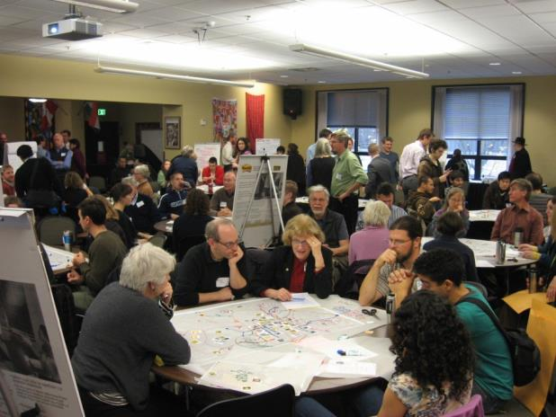
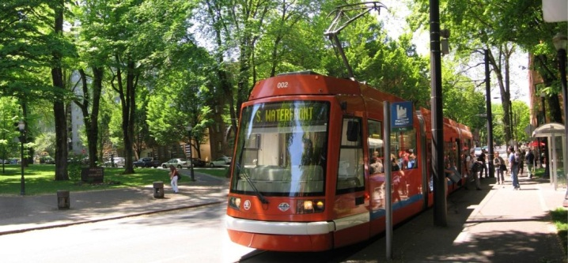
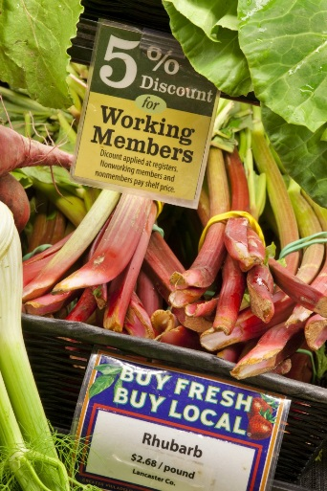
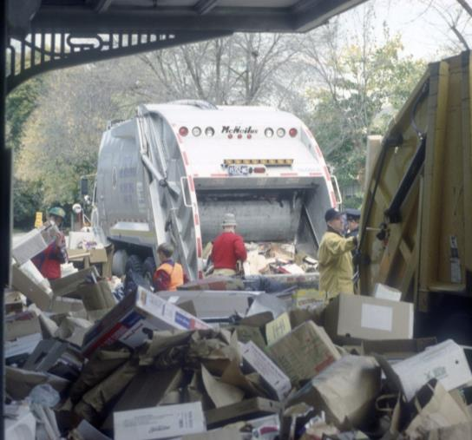
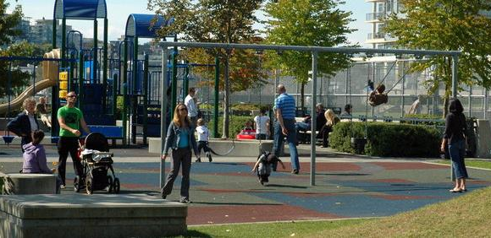
What are Ecodistricts?
Other Leading Ecodistrict Cities
San Francisco, CA
Washington, DC
Portland, OR
Pittsburgh, PA
Cleveland, OH
Austin, TX
Boston, MA
Denver, CO
Charleston, SC
Orlando, FL
San Diego, CA
Burlington, VT
Detroit, MI
Vancouver, BC
Notes:
In practice, an EcoDistrict is a community that defines how it wants to interact with things like transit, local food, and even waste to create a place that suits the needs and wants of its members, creating a resilient, sustainable and most of all proud community.
It is a next generation neighborhood that combines livability, green infrastructure
and community decision-making.

Slide 7
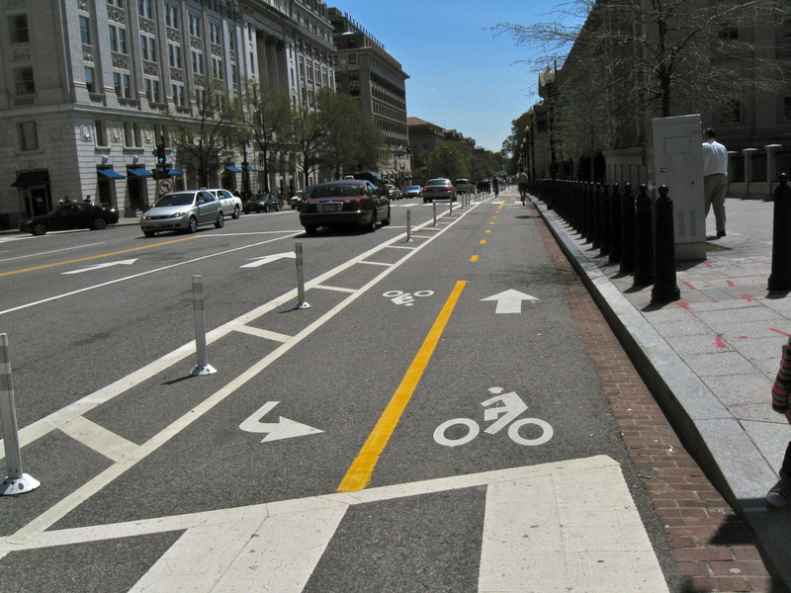
Midtown Greenprint
Midtown Atlanta Greenprints
Ecodistrict Priorities
Building Energy/Water Efficiency Recycling
Green Infrastructure
Parks + Greenspace
Transportation
Notes:
Right here in Atlanta the Midtown Alliance undertook the first local EcoDistrict in 2012. To build on previously conducted sustainability plans the Midtown Alliance used the ED framework to gather community input for future programs and plans.
Projects:
Over 1,000 community members participated in the process resulting in 50 public recycling containers, a 3,000 gallon cistern to capture rain water and provide an eco-friendly and free source of water for local greenspace. Four miles of requested bike lanes have been installed with 10 more on the way, providing a great exercise and transportation resource for residence and visitors. They are also working with local restaurants on comprehensive composting, condos on better recycling access and are allowing local businesses to adopt and enhance available tree wells.

Slide 8
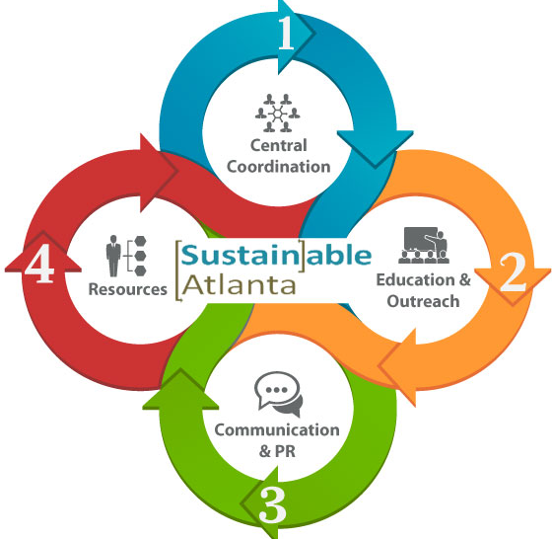
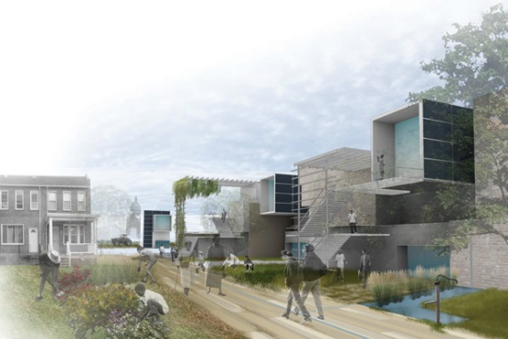
Greater Atlanta Ecodistrict Initiative
2015
Building first robust metro network of Ecodistricts in U.S.
2014
Beta testing model in university, urban residential + suburban town center settings
2012-3
Midtown pilot
Task Force
Building Partnerships
Notes:
Millvale near Pittsburg. Suburb with a rural and industrial feel, suffered from exodus of traditional industry, leaving many large buildings vacant. Also had sever flooding problem due to its location at the bottom of a watershed area.
Decided to focus on rehabbing the community with urban farming, water management and energy independence. Also had some other ‘low hanging fruit’ that the community identified as good ways to bring cohesion and strength to the area.
Includes Millvale Gardens, creation of garden plots if former industrialized flood prone areas. Engages local community in urban ag, food processing and distribution. Interacts with youth and hopes to foster long-term creation of new economic development sector (ag).
Other fun things: Local nonprofits given permission to create interesting and informative window displays in vacant storefronts to tell public about sustainable facts.
Community Library and PV Array: Through process Millvale opened its first public library in a vacant space downtown. Not only provides books, resources and computers for local residence and serves as a meeting place, but will host solar panels for self-sufficient power. Serves as a demonstration in solar tech for community and also a pilot to allow local government to study solar tech and create necessary legal structures for its use throught community.

Slide 9
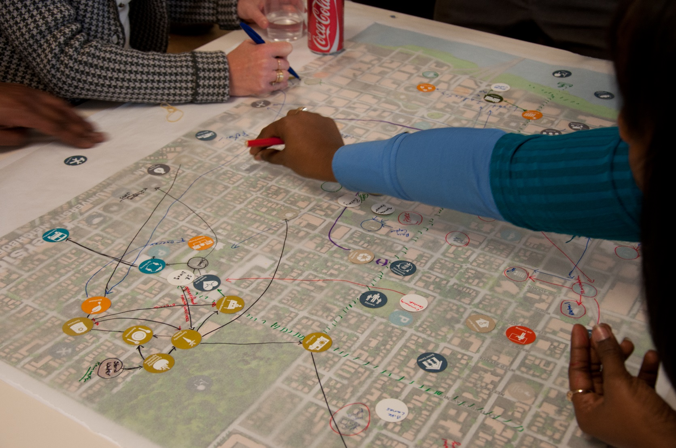
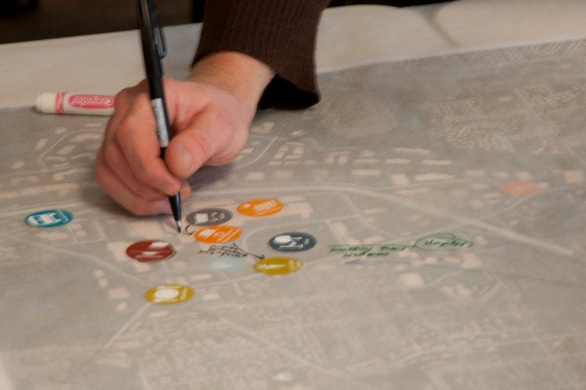
Civic Ecology – District as a System
Notes:
Millvale near Pittsburg. Suburb with a rural and industrial feel, suffered from exodus of traditional industry, leaving many large buildings vacant. Also had sever flooding problem due to its location at the bottom of a watershed area.
Decided to focus on rehabbing the community with urban farming, water management and energy independence. Also had some other ‘low hanging fruit’ that the community identified as good ways to bring cohesion and strength to the area.
Includes Millvale Gardens, creation of garden plots if former industrialized flood prone areas. Engages local community in urban ag, food processing and distribution. Interacts with youth and hopes to foster long-term creation of new economic development sector (ag).
Other fun things: Local nonprofits given permission to create interesting and informative window displays in vacant storefronts to tell public about sustainable facts.
Community Library and PV Array: Through process Millvale opened its first public library in a vacant space downtown. Not only provides books, resources and computers for local residence and serves as a meeting place, but will host solar panels for self-sufficient power. Serves as a demonstration in solar tech for community and also a pilot to allow local government to study solar tech and create necessary legal structures for its use throught community.

Slide 10
Parting Thoughts
How can your Zero Waste efforts benefit from systems thinking, and joining forces with your community?
Are there Ecodistrict efforts in your city? Reach out and connect! Start one!
If you are in metro Atlanta and want to join us in our work, please contact me at suzanne@sustainableatlanta.org, follow us on Twitter @sustain_atl and @lookupatl, on Facebook, on www.sustainableatlanta.org and www.lookupatl.org

